Slide 1
LIFELINK: MEDICAL EMERGENCY HANDLING APPLICATION
PIP2001 Capstone Project
VIVA-VOCA
Batch Number: COM-G07
ROLL NO | NAME
20211COM0010 | MEGHANA N
20211COM0014 | SANJEEVINI GAJANAND HUDDAR
20211COM0031 | NAGA SAI GAYATRI GADE
20211COM0042 | YERRAMILLI SAI PRATEEK
Under the Supervision of,
Prof. Mohamed Shakir,
Assistant Professor
School of Computer Science and Engineering
Presidency University
Name of the Program: B.Tech [Computer Engineering]
Name of the HoD: Dr. Gopal Krishna Shyam
Name of the Program Project Coordinator: Dr. Sudha P,
Name of the School Project Coordinators: Dr. Sampath A K / Dr. Abdul Khadar A / Mr. Md Ziaur Rahman

Slide 2
Introduction
Medical emergencies often demand immediate and coordinated responses.
With the advent of technology, there is an unprecedented opportunity to revolutionize how medical emergencies are managed.
Few issues in existing technologies:
Delayed response times
Lack of preparedness
Resource shortages
Elderly patient care gaps

Slide 3
Literature Review
AUTHORS | TITLE OF THE PAPER | WHEN WAS IT PUBLISHED | UNDERSTANDING OF THE PAPER
Zhang, X., & Zhang, Y. | A survey on IoT-based emergency response systems | 2020 | Explains the role of IOT in handling the emergency requests from the application.
Sahu, M., & Mohapatra, S. | Healthcare monitoring system using IoT: A review. | 2019 | Explains the existing healthcare system which uses IOT architecture.
Salem, A., & Nassar, M. | Smart healthcare systems and real time decision making for emergencies. | 2020 | Explains the algorithms used for making real- time decision on the resource allocation.

Slide 4
Literature Review
AUTHORS | TITLE OF THE PAPER | WHEN WAS IT PUBLISHED | UNDERSTANDING OF THE PAPER
Ouyang, Y., & Wang, J. | A cloud-based healthcare emergency system for public safety. | 2021 | This study presents a cloud-based healthcare emergency system aimed at bolstering public safety.
Sharma, S., & Girdhar, A. | IoT-enabled ambulance service management. | 2020 | This paper explores IoT- based solutions for efficient ambulance service management. It focuses on real- time tracking, route optimization.
Xu, D., & Zhang, Q. | Real-time hospital resource management system with mobile support. | 2021 | This article introduces a real-time hospital resource management system with mobile support, enhancing accessibility and operational efficiency.

Slide 5
Research Gaps Identified
Lack of Real-Time Emergency Network : The absence of a real-time emergency communication network severely delays the coordination and response efforts during critical situations
Inefficient Response to Mass Emergencies : The inability to swiftly mobilize resources and personnel in mass emergencies leads to prolonged response times and increased casualties.
Limited Usability for all Users : Emergency systems often fail to accommodate diverse user needs, such as ambulance tracking, which makes it difficult to know how long it takes for the arrival of help.
Inefficient Use of ML for Smartwatch Integration: Machine learning models used in emergency prediction are often underutilized or inaccurate, hindering proactive measures and timely interventions.
Lack of Data Interoperability : The fragmentation of emergency data systems across agencies prevents seamless sharing of critical information, like blood groups, patient details, etc.

Slide 6
Proposed Method
LifeLink addresses the limitations of existing apps by providing:
Improving Response Times: Reduce the time taken from the emergency request to reaching the appropriate medical assistance.
Enhance Accessibility: Ensure that users in remote or underserved areas can easily access emergency services.
Optimize Resource Management: Utilize AI and machine learning for smart resource allocation, ensuring that ambulances, hospitals, and blood banks are always ready and available.
Real-Time Data Handling: Firebase is used to store user data and sync it across devices.

Slide 7
Objectives
The primary objective of this project is to develop a emergency handling application that helps users in:
Minimizing emergency response time.
Elderly safety using IoT monitoring.
Provide CPR instructions.
Enable real-time, secure, and efficient communication among patients, ambulances, hospitals, and blood banks.
Track/Navigate the ambulance.

Slide 8
System Design and Implementation
Emergency Handling Module: Accepts emergency requests from various sources, such as mobile applications, phone calls, or other integrated systems. Implements geospatial matching algorithms to efficiently identify the nearest available ambulances and resources based on the location of the emergency.
Hospital Resource Management Module: Stores and updates real-time information on hospital capacity, including bed availability, ICU availability, and specialized services. Utilizes predictive algorithms to anticipate potential surges in demand and proactively allocate resources accordingly.
Blood Bank Integration Module: Tracks real-time blood stock availability across multiple blood banks using APIs. Sends timely notifications to healthcare providers about the availability of compatible blood types for patients in need. Facilitates efficient blood supply chain management by connecting blood banks with hospitals and other healthcare facilities.
Authentication: Users register or log in to the system using secure credentials such as usernames, passwords, or biometric data. Their credentials are validated using industry-standard security measures, such as encryption and hashing algorithms.
Backend Data Storage Module: Handles real-time syncing using Firebase.

Slide 9
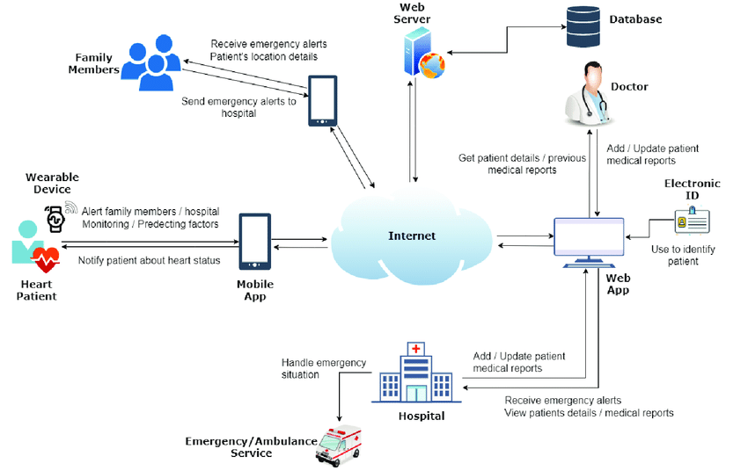
Architecture

Slide 10
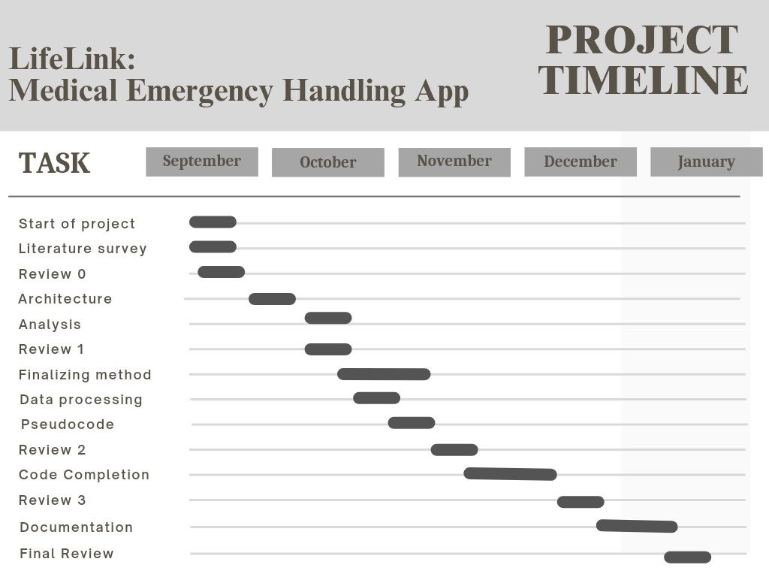
Timeline of Project

Slide 11
Results & Outcomes Obtained
1. Reduced Response Time:
Real-time Hospital Selection: By analyzing the patient’s location, the system ensures that patients are directed to the nearest hospital.
2. Improved Resource Management:
Blood Bank Integration: Real-time synchronization with blood banks ensures that available blood types and quantities are instantly accessible.
3. Scalable Emergency Management:
Handling Mass Emergencies: The system utilizes MongoDB’s distributed architecture, enabling it to scale quickly and handle emergencies involving a large number of patients.
Centralized Decision Making: The centralized aggregation of data supports informed, rapid decision-making in critical situations.
4. Elderly Care:
Continuous Monitoring: The integration of IoT devices into the system provides ongoing health monitoring for elderly individuals.

Slide 12
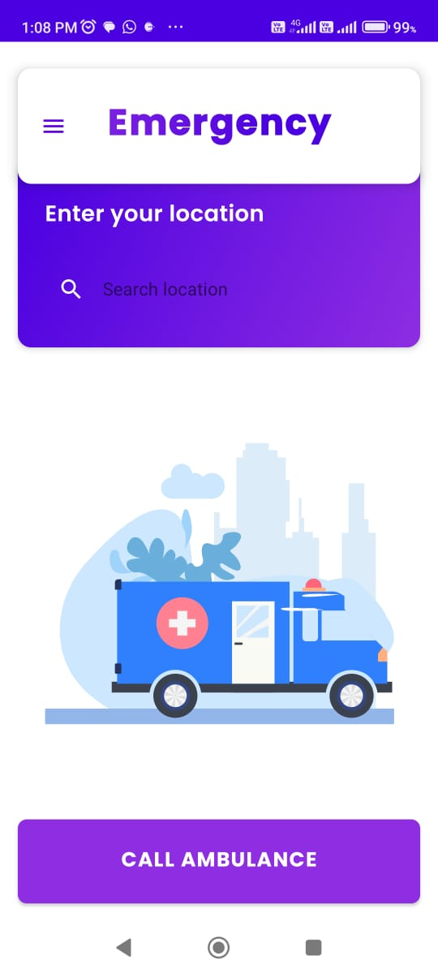
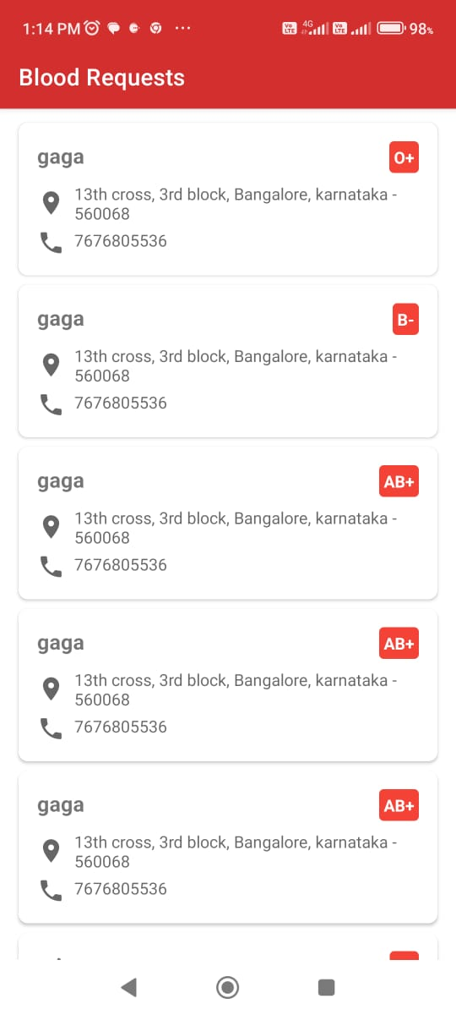
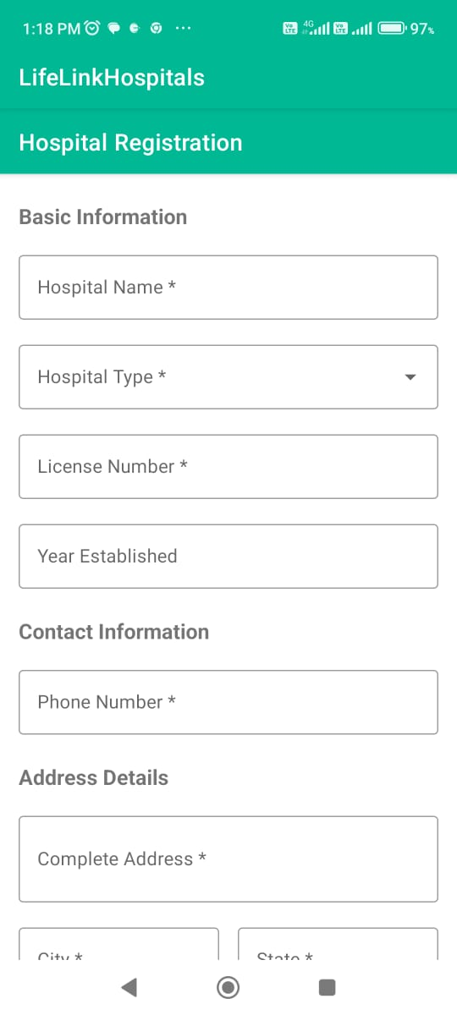
Results & Outcomes Obtained
Home Screen LifeLink User App
Details Of Various Blood Groups in the LifeLink Blood Bank App
Hospital Registration Form in LifeLink Hospital App
Ride Requests Sent to Registered Drivers on LifeLink Driver App

Slide 13
Results & Outcomes Obtained
Feature | Existing Technologies | LifeLink
First Aid Guidance | Most existing systems do not provide text-based first aid instructions. | LifeLink gives the user CPR instructions to help the user with instructions until the arrival of Ambulance.
Blood Bank Integration | Most of the existing systems do not have the option to integrate Blood Bank within the app. | LifeLink has a Blood Bank app for the hospital, which makes sure that the particular blood group can be delivered to a patient who arrives with an emergency
Coordination within various users | Most systems do not provide proper integration between drivers, hospitals and users. | LifeLink has a specific version for each user and ensures collaboration remains smooth between different users.
Table Comparing LifeLink To Existing Technologies

Slide 14
Conclusion
The LifeLink system, developed with Java, MongoDB, and Spring Boot, offers a real-time, scalable solution to bridge gaps in existing emergency response systems. By utilizing GPS tracking, IoT devices for elderly care, and seamless communication between ambulances and hospitals, it minimizes delays and optimizes emergency response. The system ensures timely intervention and better resource coordination, directing ambulances to hospitals with the necessary resources while enhancing patient care.
The app’s user-centric design, with features like voice commands and multi-language support, makes it accessible to all users, particularly elderly individuals with limited technological experience. With MongoDB’s distributed architecture and Spring Boot, the system is built to scale and handle large volumes of data efficiently, making it suitable for both small emergencies and large-scale disasters.

Slide 15
References
[1] Zhang, X., & Zhang, Y. (2020). "A survey on IoT-based emergency response systems.” - Journal of Intelligent & Fuzzy Systems, 39(5), pp. 6165-6174. https://doi.org/10.3233/JIFS-189237
[2] Sahu, M., & Mohapatra, S. (2019). "Healthcare monitoring system using IoT: A review." - Procedia Computer Science, 132, pp.397-402. https://doi.org/10.1016/j.procs.2018.05.198
[3] Li, K., Zhang, H., & Liu, Y. (2021). "Real-time ambulatory healthcare services: A case study of IoT-based smart health systems.” - Sensors, 21(6), pp.1867. https://doi.org/10.3390/s21061867
[4] Sharma, S., & Girdhar, A. (2020). "IoT-enabled ambulance service management.” - Procedia Computer Science, 167, pp.2261-2270. https://doi.org/10.1016/j.procs.2020.03.277
[5] Chien, S., & Ding, W. (2019). "Predictive analytics in healthcare: A survey." - IEEE Access, 7, pp.168838-168852. https://doi.org/10.1109/ACCESS.2019.2954429
[6] Salem, A., & Nassar, M. (2020). "Smart healthcare systems and real-time decision making for emergencies.” - Health Informatics Journal, 26(2), pp. 888-902. https://doi.org/10.1177/1460458219849522
[7] Patel, S., & Bansal, A. (2020). "Data-driven decision-making for ambulance and patient management systems." - IEEE Transactions on Industrial Informatics, 16(5), pp. 3271-3280. https://doi.org/10.1109/TII.2019.2945362

Slide 16
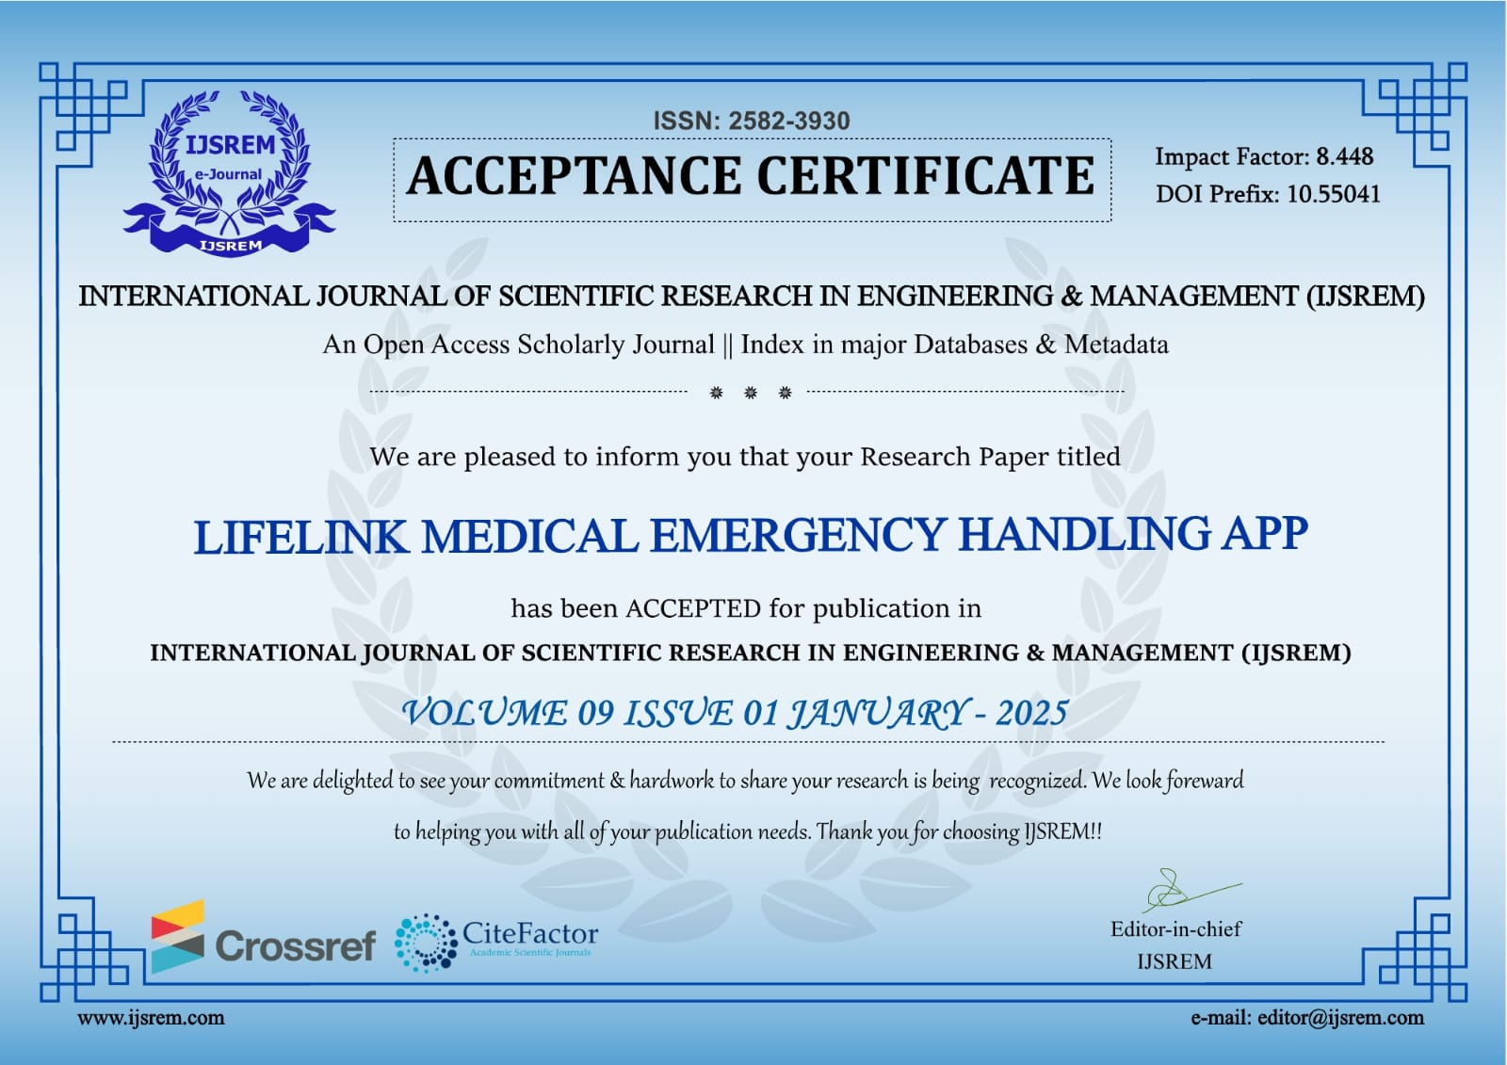
Publication Details

Slide 17

Project work mapping with SDG
The project described aligns with SDG 3: Good Health and Well-Being and SDG 11:
Sustainable Cities and Communities.
Why it aligns with SDG 3:
SDG 3 focuses on ensuring healthy lives and promoting well-being for all at all ages. The
project aims to address critical healthcare challenges, especially during emergencies, by using
technology to save time, provide immediate assistance, and improve the efficiency of resource
management.

Slide 18

Project work mapping with SDG
Why it aligns with SDG 11:
SDG 11 focuses on making cities and human settlements inclusive, safe, resilient, and sustainable. Your emergency handling application plays a vital role in improving disaster preparedness, strengthening resilience, and ensuring safe and accessible emergency responses in urban settings, contributing to the overall safety of
communities.

Slide 19
GitHub Repository Link
https://github.com/meghs10/LifeLink.git

Slide 20
Thank You

